Slide 1

CHAPTER 3
THE LOGIC OF
QUANTIFIED
STATEMENTS
Copyright © Cengage Learning. All rights reserved.

Slide 2
SECTION 3.3
Statements with Multiple Quantifiers
Copyright © Cengage Learning. All rights reserved.

Slide 3
Statements with Multiple Quantifiers
When a statement contains more than one quantifier, we imagine the actions suggested by the quantifiers as being performed in the order in which the quantifiers occur.
For instance, consider a statement of the form
∀x in set D, ∃y in set E such that x and y satisfy property P(x, y).

Slide 4
Statements with Multiple Quantifiers
To show that such a statement is true, you must be able to meet the following challenge:
Imagine that someone is allowed to choose any element whatsoever from the set D, and imagine that the person gives you that element. Call it x.
The challenge for you is to find an element y in E so that the person’s x and your y, taken together, satisfy property P(x, y).

Slide 5
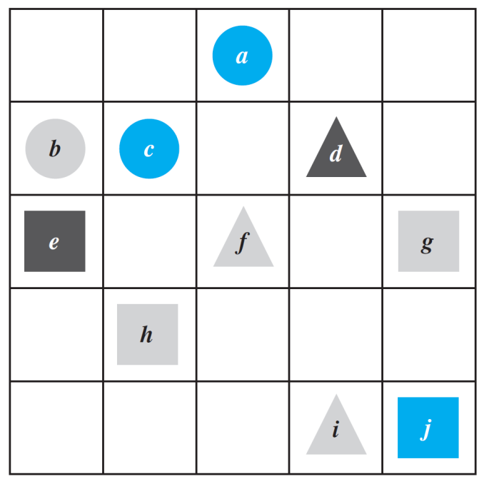
Example 1 – Truth of a ∀∃ Statement in a Tarski World
Consider the Tarski world shown in Figure 3.3.1.
Show that the following statement is true in this world:
For all triangles x, there is a square y such that x and y have the same color.
Figure 3.3.1

Slide 6
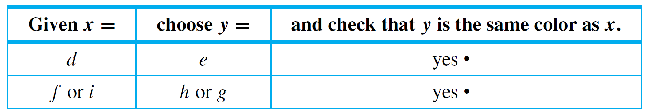
Example 1 – Solution
The statement says that no matter which triangle someone gives you, you will be able to find a square of the same color. There are only three triangles, d, f, and i.
The following table shows that for each of these triangles a square of the same color can be found.

Slide 7
Statements with Multiple Quantifiers
Now consider a statement containing both ∀ and ∃, where the ∃ comes before the ∀:
∃ an x in D such that ∀y in E, x and y satisfy property P(x, y).
To show that a statement of this form is true:
You must find one single element (call it x) in D with the following property:
After you have found your x, someone is allowed to choose any element whatsoever from E. The person challenges you by giving you that element. Call it y.
Your job is to show that your x together with the person’s y satisfy property P(x, y).

Slide 8
Statements with Multiple Quantifiers
Here is a summary of the convention for interpreting statements with two different quantifiers:
Interpreting Statements with Two Different Quantifiers
If you want to establish the truth of a statement of the form
∀x in D, ∃y in E such that P(x, y)
your challenge is to allow someone else to pick whatever element x in D they wish and then you must find an element y in E that “works” for that particular x.

Slide 9
Statements with Multiple Quantifiers
If you want to establish the truth of a statement of the form
∃x in D such that ∀y in E, P(x, y)
your job is to find one particular x in D that will “work” no matter what y in E anyone might choose to challenge you with.

Slide 10
Example 3 – Interpreting Multiply-Quantified Statements
A college cafeteria line has four stations: salads, main courses, desserts, and beverages.
The salad station offers a choice of green salad or fruit salad; the main course station offers spaghetti or fish; the dessert station offers pie or cake; and the beverage station offers milk, soda, or coffee. Three students, Uta, Tim, and Yuen, go through the line and make the following choices:
Uta: green salad, spaghetti, pie, milk
Tim: fruit salad, fish, pie, cake, milk, coffee
Yuen: spaghetti, fish, pie, soda

Slide 11
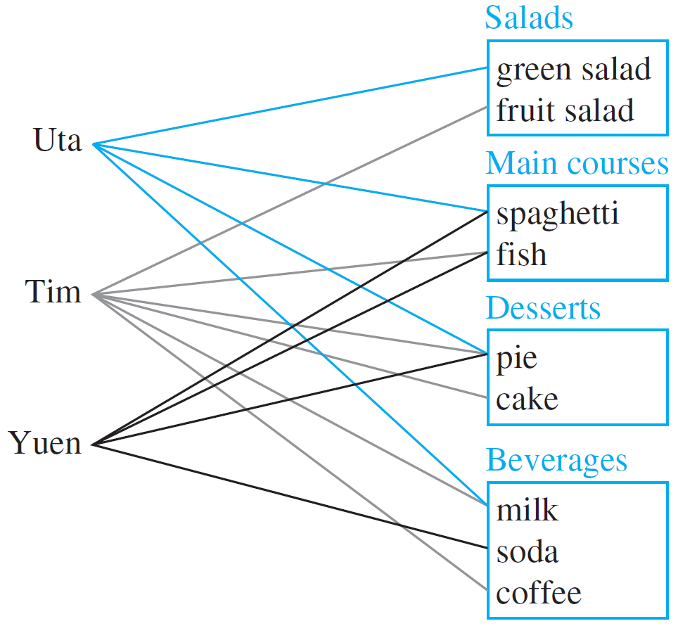
Example 3 – Interpreting Multiply-Quantified Statements
cont’d
These choices are illustrated in Figure 3.3.2.
Figure 3.3.2

Slide 12
Example 3 – Interpreting Multiply-Quantified Statements
cont’d
Write each of following statements informally and find its truth value.
a. ∃ an item I such that ∀ students S, S chose I.
b. ∃ a student S such that ∀ items I, S chose I.
c. ∃ a student S such that ∀ stations Z, ∃ an item I in Z
such that S chose I.
d. ∀ students S and ∀ stations Z, ∃ an item I in Z such that
S chose I.

Slide 13
Example 3 – Solution
a. There is an item that was chosen by every student. This
is true; every student chose pie.
b. There is a student who chose every available item. This is false; no student chose all nine items.
c. There is a student who chose at least one item from every station. This is true; both Uta and Tim chose at least one item from every station.
d. Every student chose at least one item from every station. This is false; Yuen did not choose a salad.

Slide 14
Translating from Informal
to Formal Language

Slide 15
Translating from Informal to Formal Language
Most problems are stated in informal language, but solving them often requires translating them into more formal terms.

Slide 16
Example 4 – Translating Multiply-Quantified Statements from Informal to Formal Language
The reciprocal of a real number a is a real number b such that ab = 1. The following two statements are true.
Rewrite them formally using quantifiers and variables:
a. Every nonzero real number has a reciprocal.
b. There is a real number with no reciprocal.
Solution:
a. ∀ nonzero real numbers u, ∃ a real number v such that uv = 1.
b. ∃ a real number c such that ∀ real numbers d, cd ≠ 1.
The number 0 has no reciprocal.

Slide 17
Ambiguous Language

Slide 18
Ambiguous Language
Imagine you are visiting a factory that manufactures computer microchips. The factory guide tells you,
There is a person supervising every detail of the production process.
Note that this statement contains informal versions of both the existential quantifier there is and the universal quantifier every.

Slide 19
Ambiguous Language
Which of the following best describes its meaning?
There is one single person who supervises all the details of the production process.
For any particular production detail, there is a person who supervises that detail, but there might be different supervisors for different details.

Slide 20
Ambiguous Language
Once you interpreted the sentence in one way, it may have been hard for you to see that it could be understood in the other way.
Perhaps you had difficulty even though the two possible meanings were explained.
Although statements written informally may be open to multiple interpretations, we cannot determine their truth or falsity without interpreting them one way or another.
Therefore, we have to use context to try to ascertain their meaning as best we can.

Slide 21
Negations of
Multiply-Quantified Statements

Slide 22
Negations of Multiply-Quantified Statements
You can use the same rules to negate multiply-quantified statements that you used to negate simpler quantified statements.
We have known that
∼(∀x in D, P(x)) ≡ ∃x in D such that ∼P(x).
and
∼(∃x in D such that P(x)) ≡ ∀x in D,∼P(x).

Slide 23
Negations of Multiply-Quantified Statements
We apply these laws to find
∼(∀x in D, ∃y in E such that P(x, y))
by moving in stages from left to right along the sentence.
First version of negation: ∃x in D such that ∼(∃y in E such that P(x, y)).
Final version of negation: ∃x in D such that ∀y in E,
∼P(x, y).

Slide 24
Negations of Multiply-Quantified Statements
Similarly, to find
∼(∃x in D such that ∀y in E, P(x, y)),
we have
First version of negation: ∀x in D,∼(∀y in E, P(x, y)).
Final version of negation: ∀x in D, ∃y in E such that
∼P(x, y).

Slide 25
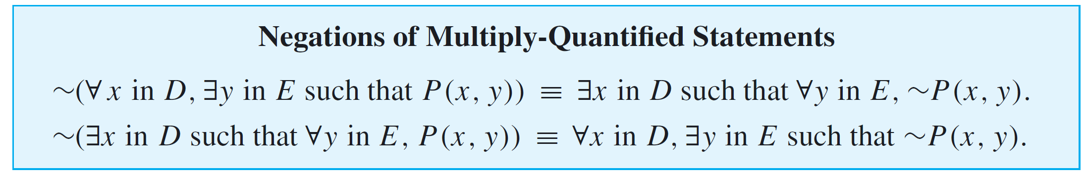
Negations of Multiply-Quantified Statements
These facts can be summarized as follows:

Slide 26
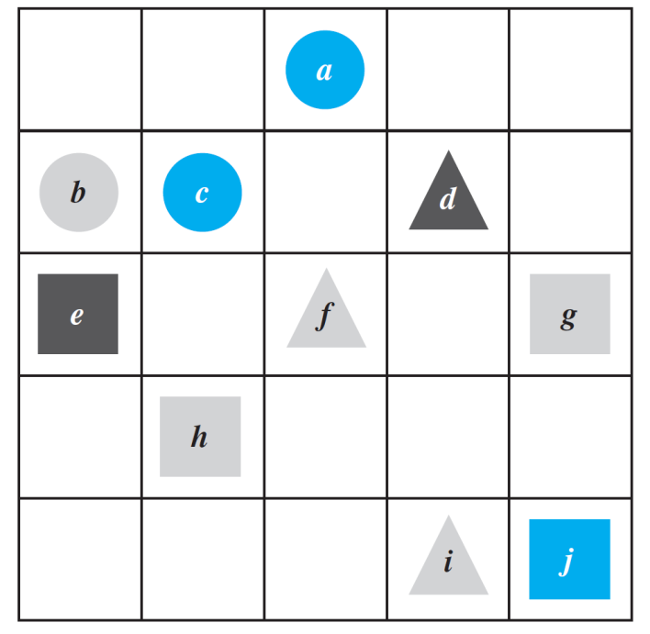
Example 8 – Negating Statements in a Tarski World
Refer to the Tarski world of Figure 3.3.1.
Write a negation for each of the
following statements, and determine
which is true, the given statement or
its negation.
a. For all squares x, there is a circle y
such that x and y have the same
color.
b. There is a triangle x such that for all
squares y, x is to the right of y.
Figure 3.3.1

Slide 27
Example 8(a) – Solution
First version of negation: ∃ a square x such that
∼(∃ a circle y such that x and y
have the same color).
Final version of negation: ∃ a square x such that
∀ circles y, x and y do not have the same color.
The negation is true. Square e is black and no circle is black, so there is a square that does not have the same color as any circle.

Slide 28
Example 8(b) – Solution
cont’d
First version of negation: ∀ triangles x,∼ (∀ squares y, x is to the right of y).
Final version of negation: ∀ triangles x, ∃ a square y such that x is not to the right of y.
The negation is true because no matter what triangle is chosen, it is not to the right of square g (or square j ).

Slide 29
Order of Quantifiers

Slide 30
Order of Quantifiers
Consider the following two statements:
∀ people x, ∃ a person y such that x loves y.
∃ a person y such that ∀ people x, x loves y.
Note that except for the order of the quantifiers, these statements are identical.
However, the first means that given any person, it is possible to find someone whom that person loves, whereas the second means that there is one amazing individual who is loved by all people.

Slide 31
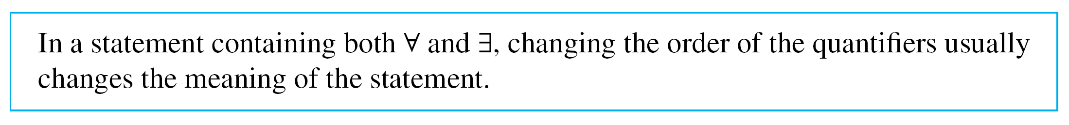
Order of Quantifiers
The two sentences illustrate an extremely important property about multiply-quantified statements:
Interestingly, however, if one quantifier immediately follows another quantifier of the same type, then the order of the quantifiers does not affect the meaning.

Slide 32
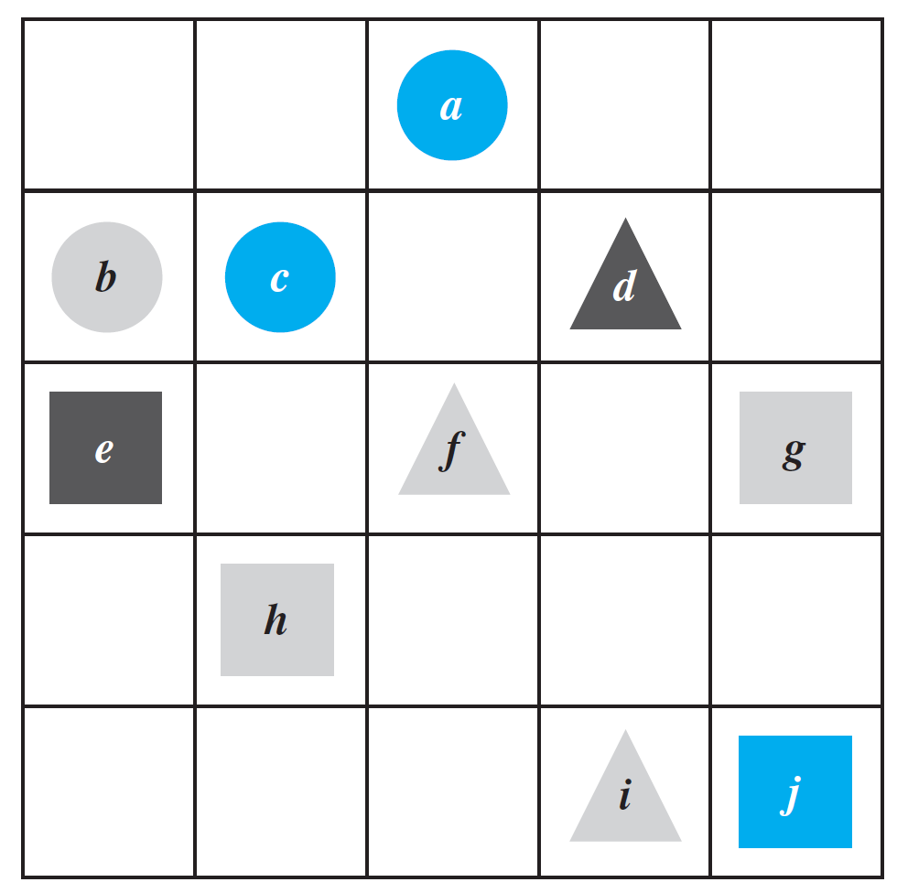
Example 9 – Quantifier Order in a Tarski World
Look again at the Tarski world of Figure 3.3.1. Do the following two statements have the same truth value?
a. For every square x there is a
triangle y such that x and y
have different colors.
b. There exists a triangle y such
that for every square x, x and y
have different colors.
Figure 3.3.1

Slide 33
Example 9 – Solution
Statement (a) says that if someone gives you one of the squares from the Tarski world, you can find a triangle that has a different color. This is true.
If someone gives you square g or h (which are gray), you can use triangle d (which is black); if someone gives you square e (which is black), you can use either triangle f or triangle i (which are both gray); and if someone gives you square j (which is blue), you can use triangle d (which is black) or triangle f or i (which are both gray).

Slide 34
Example 9 – Solution
cont’d
Statement (b) says that there is one particular triangle in the Tarski world that has a different color from every one of the squares in the world. This is false.
Two of the triangles are gray, but they cannot be used to show the truth of the statement because the Tarski world contains gray squares.
The only other triangle is black, but it cannot be used either because there is a black square in the Tarski world.
Thus one of the statements is true and the other is false, and so they have opposite truth values.

Slide 35
Formal Logical Notation

Slide 36
Formal Logical Notation
In some areas of computer science, logical statements are expressed in purely symbolic notation.
The notation involves using predicates to describe all properties of variables and omitting the words such that in existential statements.
The formalism also depends on the following facts:
“∀x in D, P(x)” can be written as “∀x(x in D → P(x)),” and
“∃x in D such that P(x)” can be written as “∃x(x in D ∧ P(x)).”
We illustrate the use of these facts in Example 10.

Slide 37
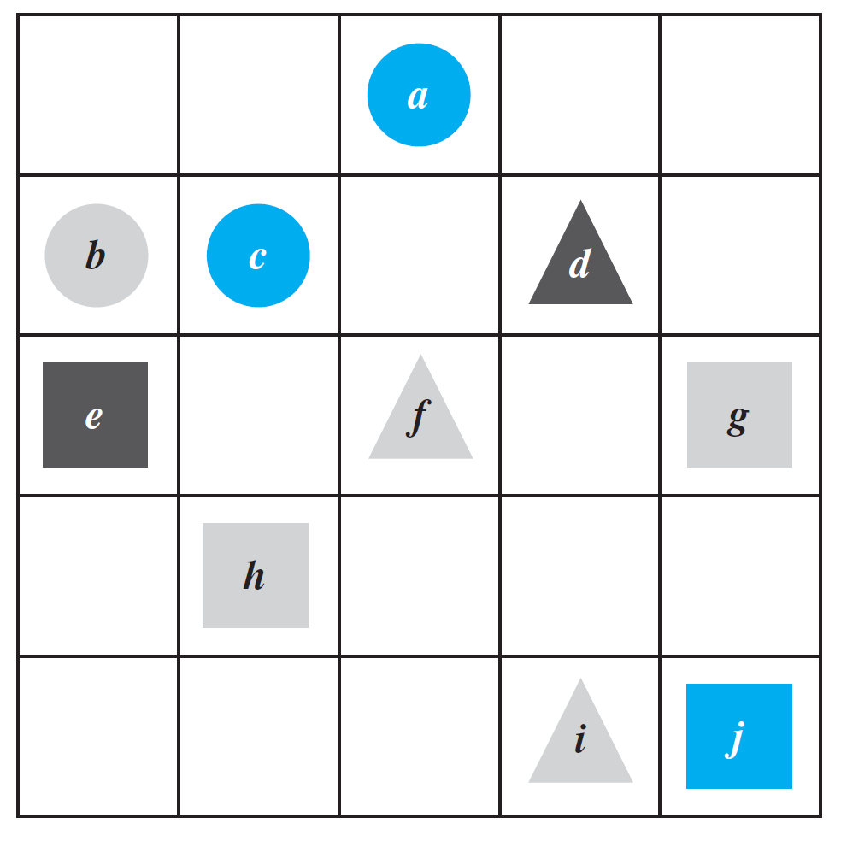
Example 10 – Formalizing Statements in a Tarski World
Consider once more the Tarski world of Figure 3.3.1:
Figure 3.3.1

Slide 38
Example 10 – Formalizing Statements in a Tarski World
cont’d
Let Triangle(x), Circle(x), and Square(x) mean “x is a triangle,” “x is a circle,” and “x is a square”; let Blue(x), Gray(x), and Black(x) mean “x is blue,” “x is gray,” and “x is
black”;
let RightOf(x, y), Above(x, y), and SameColorAs(x, y) mean “x is to the right of y,” “x is above y,” and “x has the same color as y”; and use the notation x = y to denote the predicate “x is equal to y”.
Let the common domain D of all variables be the set of all the objects in the Tarski world.

Slide 39
Example 10 – Formalizing Statements in a Tarski World
cont’d
Use formal, logical notation to write each of the following statements, and write a formal negation for each statement.
a. For all circles x, x is above f.
b. There is a square x such that x is black.
c. For all circles x, there is a square y such that x and y have the same color.
d. There is a square x such that for all triangles y, x is to right of y.

Slide 40
Example 10(a) – Solution
Statement:
∀x(Circle(x) →Above(x, f )).
Negation:
∼(∀x(Circle(x) → Above(x, f ))
≡ ∃x ∼ (Circle(x) → Above(x, f ))
≡ ∃x(Circle(x) ∧ ∼Above(x, f ))
by the law for negating a ∀ statement
by the law of negating an if-then statement

Slide 41
Example 10(b) – Solution
cont’d
Statement:
∃x(Square(x) ∧ Black(x)).
Negation:
∼(∃x(Square(x) ∧ Black(x))
≡ ∀x ∼ (Square(x) ∧ Black(x))
≡ ∀x(∼Square(x) ∨ ∼Black(x))
by the law for negating a ∃ statement
by De Morgan’s law

Slide 42
Example 10(c) – Solution
cont’d
Statement:
∀x(Circle(x) → ∃y(Square(y) ∧ SameColor(x, y))).
Negation:
∼(∀x(Circle(x) → ∃y(Square(y) ∧ SameColor(x, y))))
≡ ∃x ∼ (Circle(x) → ∃y(Square(y) ∧ SameColor(x, y)))
≡ ∃x(Circle(x) ∧ ∼(∃y(Square(y) ∧ SameColor(x, y))))
≡ ∃x(Circle(x) ∧ ∀y(∼(Square(y) ∧ SameColor(x, y))))
≡ ∃x(Circle(x) ∧ ∀y(∼Square(y) ∨ ∼SameColor(x, y)))
by the law for negating a ∀ statement
by the law for negating an if-then statement
by the law for negating a ∃ statement
by De Morgan’s law

Slide 43
Example 10(d) – Solution
cont’d
Statement:
∃x(Square(x) ∧ ∀y(Triangle(y) → RightOf(x, y))).
Negation:
∼(∃x(Square(x) ∧ ∀y(Triangle(y) → RightOf(x, y))))
≡ ∀x ∼ (Square(x) ∧ ∀y(Triangle(x) → RightOf(x, y)))
≡ ∀x(∼Square(x) ∨ ∼(∀y(Triangle(y) → RightOf(x, y))))
≡ ∀x(∼Square(x) ∨ ∃y(∼(Triangle(y) → RightOf(x, y))))
≡ ∀x(∼Square(x) ∨ ∃y(Triangle(y) ∧ ∼RightOf(x, y)))
by the law for negating a ∃ statement
by De Morgan’s law
by the law for negating a ∀ statement
by the law for negating an if-then statement

Slide 44
Formal Logical Notation
The disadvantage of the fully formal notation is that because it is complex and somewhat remote from intuitive understanding, when we use it, we may make errors that go unrecognized.
The advantage, however, is that operations, such as taking negations, can be made completely mechanical and programmed on a computer.
Also, when we become comfortable with formal manipulations, we can use them to check our intuition, and then we can use our intuition to check our formal manipulations.

Slide 45
Formal Logical Notation
Formal logical notation is used in branches of computer science such as artificial intelligence, program verification, and automata theory and formal languages.
Taken together, the symbols for quantifiers, variables, predicates, and logical connectives make up what is known as the language of first-order logic.
Even though this language is simpler in many respects than the language we use every day, learning it requires the same kind of practice needed to acquire any foreign language.

Slide 46
Prolog

Slide 47
Prolog
The programming language Prolog (short for programming in logic) was developed in France in the 1970s by A. Colmerauer and P. Roussel to help programmers working in the field of artificial intelligence.
A simple Prolog program consists of a set of statements describing some situation together with questions about the situation. Built into the language are search and inference techniques needed to answer the questions by deriving the answers from the given statements.
This frees the programmer from the necessity of having to write separate programs to answer each type of question. Example 11 gives a very simple example of a Prolog program.

Slide 48
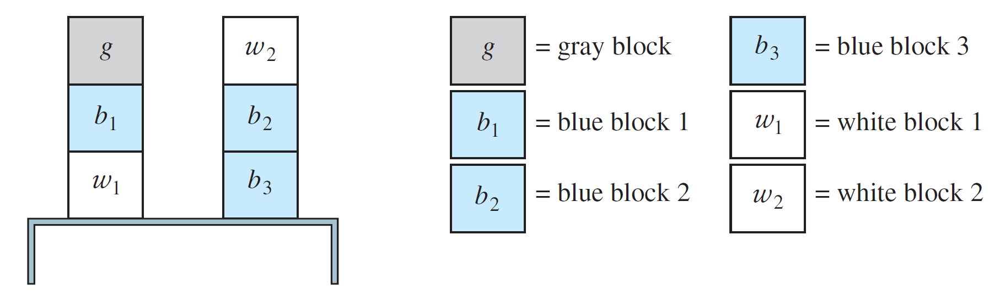
Example 11 – A Prolog Program
Consider the following picture, which shows colored blocks stacked on a table.
The following are statements in Prolog that describe this picture and ask two questions about it.
isabove(g, b₁) color(g, gray) color(b₃, blue)

Slide 49
Example 11 – A Prolog Program
cont’d
isabove(b₁, w₁) color(b₁, blue) color(w₁, white)
isabove(w₂, b₂) color(b₂, blue) color(w₂, white)
isabove(b₂, b₃) isabove(X, Z ) if isabove(X, Y ) and isabove(Y, Z)
?color(b₁, blue) ?isabove(X, w₁)
The statements “isabove(g, b₁)” and “color(g, gray)” are to be interpreted as “g is above b₁” and “g is colored gray”. The statement “isabove(X, Z ) if isabove(X, Y ) and isabove(Y, Z )” is to be interpreted as “For all X, Y, and Z, if X is above Y and Y is above Z, then X is above Z.”

Slide 50
Example 11 – A Prolog Program
cont’d
The program statement
?color(b₁, blue)
is a question asking whether block b₁ is colored blue. Prolog answers this by writing
Yes.
The statement
?isabove(X, w₁)
is a question asking for which blocks X the predicate “X is above w₁” is true.

Slide 51
Example 11 – A Prolog Program
cont’d
Prolog answers by giving a list of all such blocks. In this case, the answer is
X = b₁, X = g.
Note that Prolog can find the solution X = b₁ by merely searching the original set of given facts. However, Prolog must infer the solution X = g from the following statements:
    isabove(g, b₁),
    isabove(b₁,w₁),
isabove(X, Z ) if isabove(X, Y ) and isabove(Y, Z ).

Slide 52
Example 11 – A Prolog Program
cont’d
Write the answers Prolog would give if the following questions were added to the program above.
a. ?isabove(b₂, w₁) b. ?color(w₁, X ) c. ?color(X, blue)
Solution:
a. The question means “Is b₂ above w₁?”; so the answer is “No.”
b. The question means “For what colors X is the predicate ‘w₁ is colored X ’ true?”; so the answer is “X = white.”

Slide 53
Example 11 – Solution
cont’d
c. The question means “For what blocks is the predicate ‘X is colored blue’ true?”; so the answer is “X = b₁,” “X = b₂,” and “X = b₃.”

